Slide 1
Decision Tree Classification (ID3)
Presented By:
ANANTHU RAJ

Slide 2
CONTENTS
Introduction to Decision Tree
How Decision Tree Works ?
Cost Function in a Decision Tree
Iterative Dichotomiser(ID3)
Entropy
Information Gain
Over-fitting Problem and how to avoid it
Advantages
Disadvantages
Conclusion

Slide 3
Introduction
Supervised learning algorithm
Used for both classification and regression problems
Does not require feature scaling
Easy to interpret
Prone to Overfitting

Slide 4
An example of a binary classification categorizing a car type as a sedan or sports truck follows as below.
The algorithm finds the relationship between the response variable and the predictors and expresses this relation in the form of a tree-structure.
This flow-chart consists of the Root node, the Branch nodes, and the Leaf nodes.
The model is trained by creating a top-down tree and then this trained decision tree is used to test the new or the unseen data to classify these cases into a category.

Slide 5
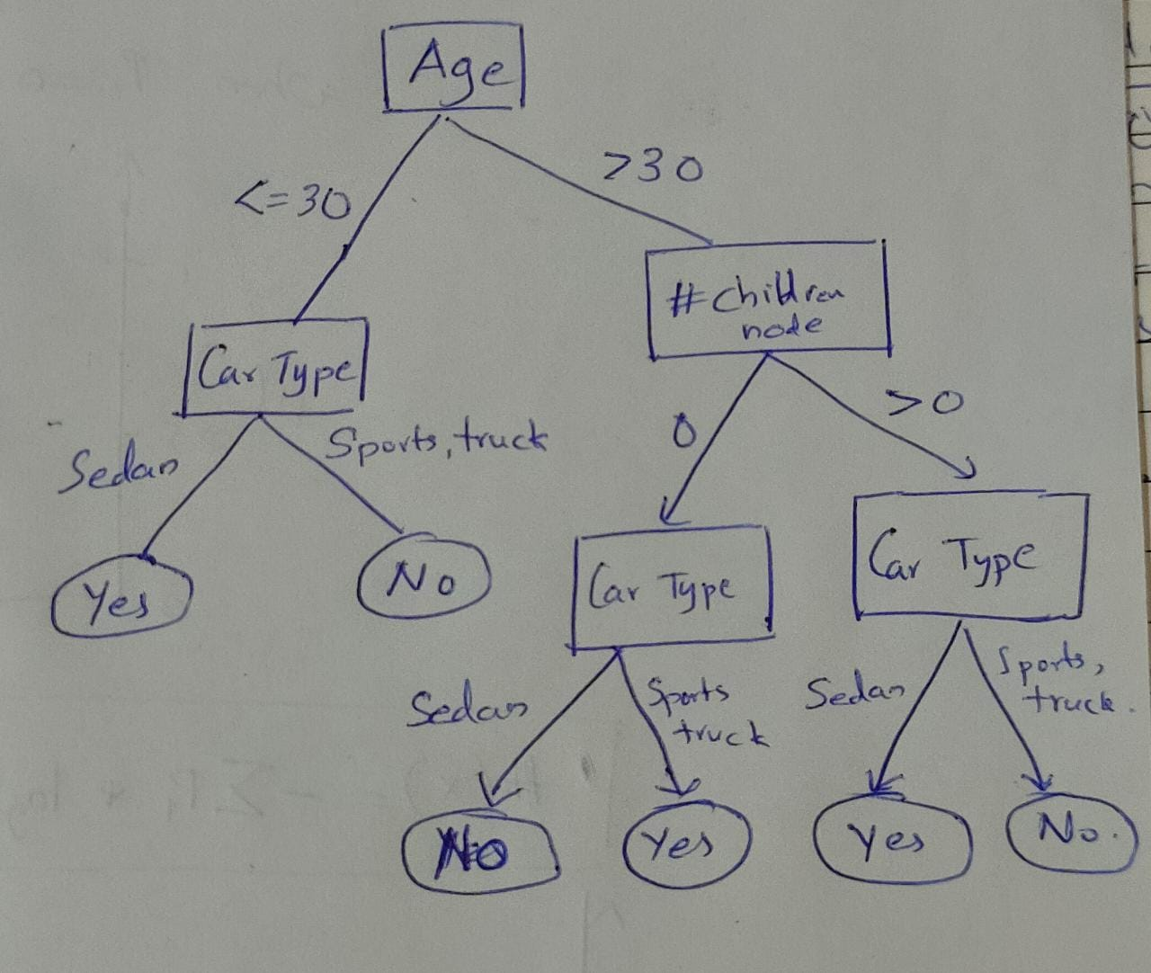

Slide 6
HOW DECISION TREE WORKS ?
The decision tree algorithm tries to solve the problem, by using tree representation.
Each internal node of the tree corresponds to an attribute, and each leaf node corresponds to a class label.
In decision trees, for predicting a class label for a record we start from the root of the tree.
We compare the values of the root attribute with the record’s attribute. On the basis of comparison, we follow the branch corresponding to that value and jump to the next node.
We continue comparing our record’s attribute values with other internal nodes of the tree until we reach a leaf node with predicted class value.

Slide 7
Cost Function in a Decision Tree
The decision tree algorithm learns that it creates the tree from the dataset via the optimization of the cost function.
There are various splitting methods including
Chi-square,
Gini-index,
and Entropy
The Gini index is a measure of impurity in a dataset used to evaluate the quality of splits in decision tree algorithms. The Gini index is calculated as the sum of the squared probability of each class in the node, with a perfect split resulting in a Gini index of 0, and a random split resulting in a Gini index of 0.5.

Slide 8
Iterative Dichotomiser(ID3)
Invented by J. Ross Quinlan in 1979.
It uses entropy, and a related concept, information gain, to choose features and partitions at each classification step in the tree.
Information gain is the difference between the current entropy of a system and the entropy measured after a feature is chosen.

Slide 9

Entropy
Entropy is a measure of impurity in a dataset
It is calculated as the sum of the negative probabilities of each class in the node
Claude E. Shannon had expressed this relationship between the probability and the heterogeneity or impurity in the mathematical form with the help of the following equation:

Slide 10
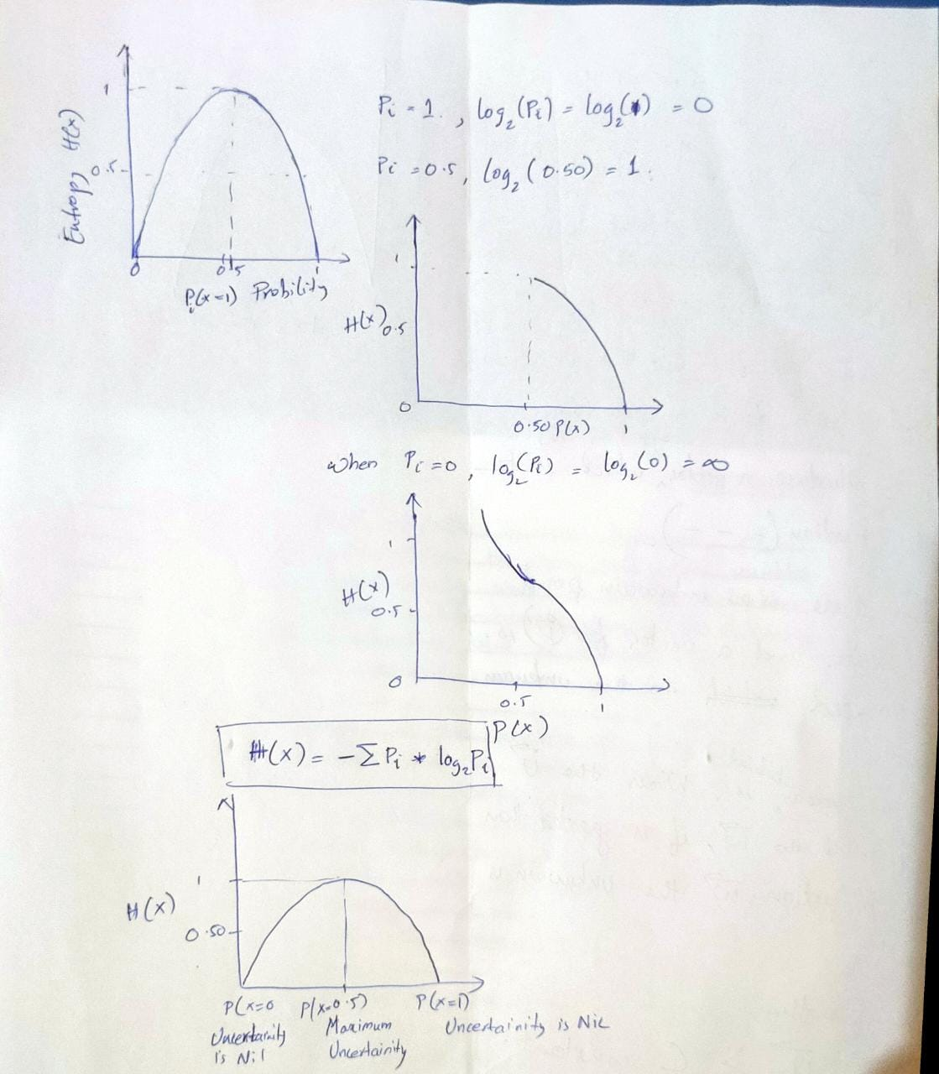

Slide 12
Information Gain
Information gain is a measure of the reduction in entropy that results from a split in the data.
Used to determine the best feature to split the data on at each node.
The feature that provides the most information gain, or reduction in entropy, is selected as the splitting feature.
Information gain is calculated as the difference between the entropy of the original set and the weighted average of the entropy of the subsets created by a split.
Information Gain = Entropy(original set) - Weighted average of entropy of subsets

Slide 13
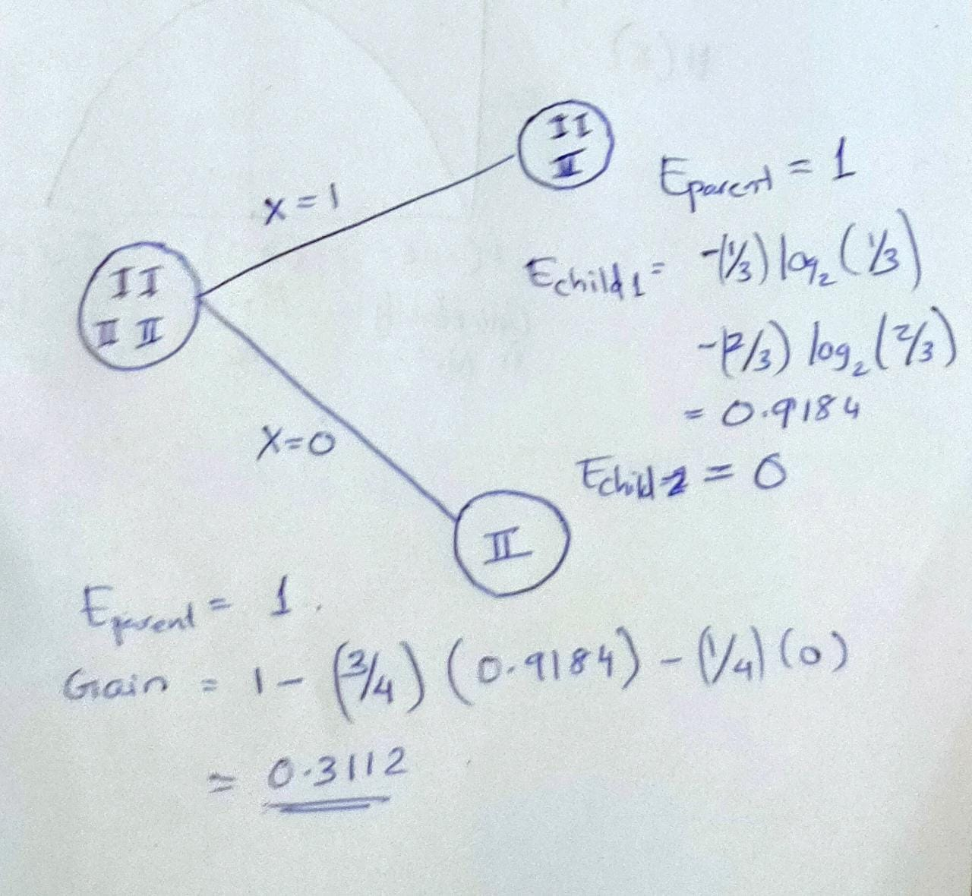

Slide 14
OVERFITTING
Overfitting is considered when the algorithm continues to go deeper and deeper in the to reduce the training set error but results with an increased test set error i.e, Accuracy of prediction for our model goes down.
Due to outliers and irregularities in data.
Two approaches which we can use to avoid overfitting are:
Pre-Pruning
Post-Pruning

Slide 15
Pruning is a technique used in decision tree algorithms to reduce the size of the tree by removing branches that are not significant. The goal of pruning is to reduce the complexity of the tree and avoid overfitting, which occurs when the tree becomes too complex and captures too much noise in the data.
Pre-pruning is a type of pruning that takes place before the tree is fully grown. It involves setting a maximum depth for the tree, limiting the number of features to consider for each split, or using a minimum number of samples required to split a node.
Post-pruning is a type of pruning that takes place after the tree is fully grown. It involves removing sub-trees that do not significantly impact the accuracy of the predictions. The process of post-pruning usually involves evaluating the accuracy of the tree on a validation set and removing sub-trees that do not improve the accuracy.

Slide 16
ADVANTAGES:
Easy to interpret and explain.
Can handle both categorical and numerical data
The algorithm uses entropy and information gain as the measures of impurity, which help in finding the most significant attribute for the tree formation.
Ability to handle missing values and outliers
The algorithm is computationally efficient and can handle large datasets

Slide 17
DISADVANTAGES
Overfitting
Instability
Bias towards features with many levels
Unnecessarily complex trees
Inefficient with large datasets
ID3 doesn't consider the order of values

Slide 18
Conclusion
Information Entropy or Shannon’s entropy quantifies the amount of uncertainty (or surprise) involved in the value of a random variable or the outcome of a random process. Its significance in the decision tree is that it allows us to estimate the impurity or heterogeneity of the target variable.
Subsequently, to achieve the maximum level of homogeneity in the response variable, the child nodes are created in such a way that the total entropy of these child nodes must be less than the entropy of the parent node.

Slide 19
THANK YOU

